Slide 1
Regularization

Slide 2
Purpose of regularization
To prevent overfitting by adding a penalty to the loss function used to optimize the model's coefficients
  L1 regularization (Lasso)
  L2 regularization (Ridge)
  Elastic Net

Slide 3

L1 Regularization (Lasso Regularization)
In L1 regularization, a penalty proportional to the absolute value of the magnitude of the coefficients is added to the loss function
It performs both regularization and feature selection by driving some coefficients to zero

Slide 4
L1 Regularization (Lasso Regularization)
Effect
L1 regularization leads to sparse models, where some of the feature weights (coefficients) are driven to zero
  it selects only a subset of features, performing automatic feature selection
It is useful when we expect
  some of the features to be irrelevant, or
  the number of features is much larger than the number of data points
Use Cases
Lasso is effective when the dataset contains irrelevant features and we want to automatically perform feature selection
It works well in cases of high-dimensional data (many features)

Slide 5
L1 regularization does not help with multicollinearity
L1 tries to select features.
When two or more features are highly correlated, L1 sees them as redundant.
Instead of sharing weight among them, it tends to pick one feature and push the others to zero.
This behavior is unstable because small changes in the data can make L1 switch which feature it keeps.

Slide 6

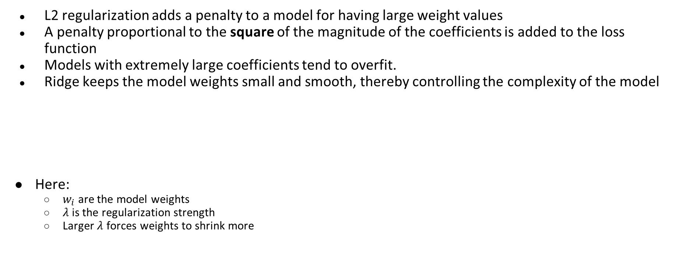
L2 Regularization (Ridge Regularization)
L2 regularization adds a penalty to a model for having large weight values
A penalty proportional to the square of the magnitude of the coefficients is added to the loss function
Models with extremely large coefficients tend to overfit.
Ridge keeps the model weights small and smooth, thereby controlling the complexity of the model
Here:
  $w_{i}$ are the model weights
  $λ$is the regularization strength
  Larger $λ$ forces weights to shrink more

Slide 7


A very small example: one feature and one weight
we want to find weight w that minimizes
Loss(w)=(y−wx)²+λw²
Setting it to zero gives:
This number is never exactly zero unless y=0.
The Ridge formula always produces a shrunk but nonzero value.

Slide 8
L2 Regularization (Ridge Regularization)
Effect
L2 regularization tends to shrink the weights, but typically does not drive them to zero
It smoothens the model, reducing the risk of overfitting by reducing the impact of less important features
Works well in situations where many features contribute to the outcome
Use Cases
Ridge regression is effective when the dataset has a high degree of multicollinearity (correlated input features)
Helps in cases where we expect most features to contribute in some way, but we want to avoid large coefficients

Slide 9
L2 regularization help with multicollinearity
When two features are correlated
  instead of trying to pick one feature or flip between them, L2 spreads the weight across both.

Slide 10
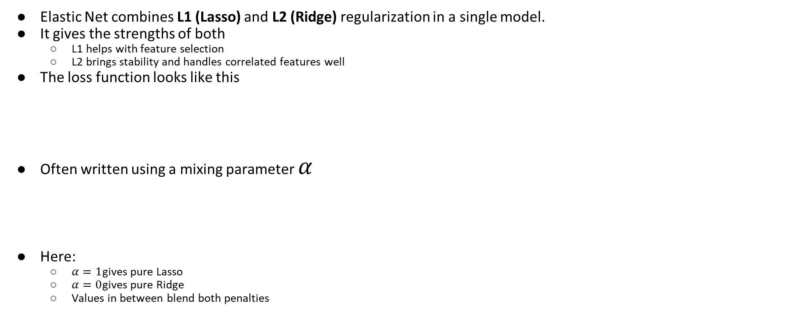

Elastic Net Regularization

